Slide 1
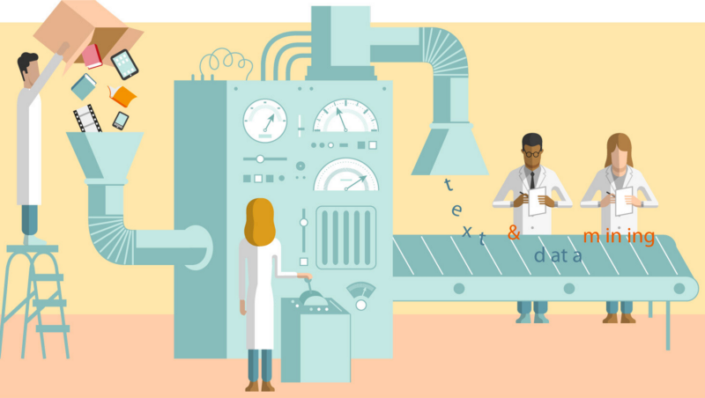
Data Preparation

Slide 2
Understand the problem 1
Problem: You were hired by a bank to help with data analysis, and to predict how much money the bank will lose if it gives out a loan to a particular client (0 – if the client will return loan, 100% - otherwise).
Solution:
1 – Regression (The amount of loss?) Y is R
2 – Classification (1-returned, 0-not) Y {0,1}
3 – Classterization (Find related clients) Y=?
Business point: Things that do not acctually depend on programming (recommendation could depend on the quality of image,…)

Slide 3
Data Preparation
• Introduction to Data Preparation
• Types of Data
• Discretization of Continuous Variables
• Outliers
• Data Transformation
• Missing Data
• Handling Redundancy
• Sampling and Unbalanced Datasets

Slide 4
Why Prepare Data?
• Some data preparation is needed for all mining tools
• The purpose of preparation is to transform data sets so that their information content is best exposed to the mining tool
• Error prediction rate should be lower (or the same) after the preparation as before it
• Preparing data also prepares the miner so that when using prepared data the miner produces better models, faster
• GIGO - good data is a prerequisite for producing effective models of any type

Slide 5
Why Prepare Data?
• Data need to be formatted for a given software tool
• Data need to be made adequate for a given method
• Data in the real world is dirty
• incomplete: lacking attribute values, lacking certain attributes of interest, or
containing only aggregate data
• e.g., occupation=“”
• noisy: containing errors or outliers
• e.g., Salary=“-10”, Age=“222”
• inconsistent: containing discrepancies in codes or names
• e.g., Age=“42” Birthday=“03/07/1997”
• e.g., Was rating “1,2,3”, now rating “A, B, C”
• e.g., discrepancy between duplicate records
• e.g., Endereço: travessa da Igreja de Nevogilde Freguesia: Paranhos

Slide 6
Major Tasks in Data Preparation
• Data discretization
• Part of data reduction but with particular importance, especially for numerical data
• Data cleaning
• Fill in missing values, smooth noisy data, identify or remove outliers, and resolve inconsistencies
• Data integration
• Integration of multiple databases, data cubes, or files
• Data transformation
• Normalization and aggregation
• Data reduction
• Obtains reduced representation in volume but produces the same or similar analytical results

Slide 7
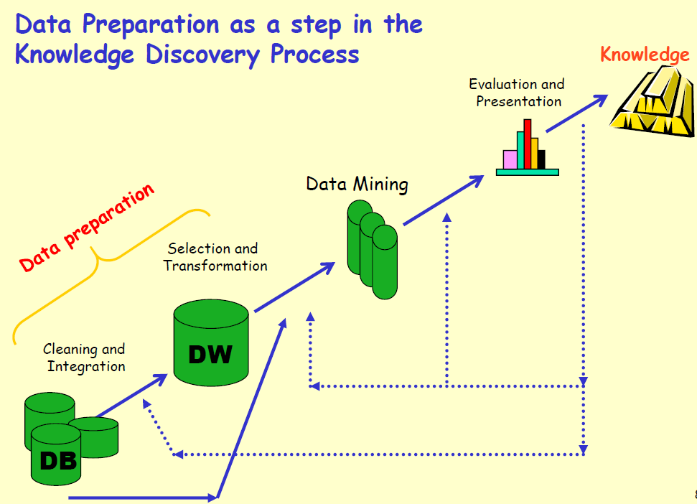

Slide 8
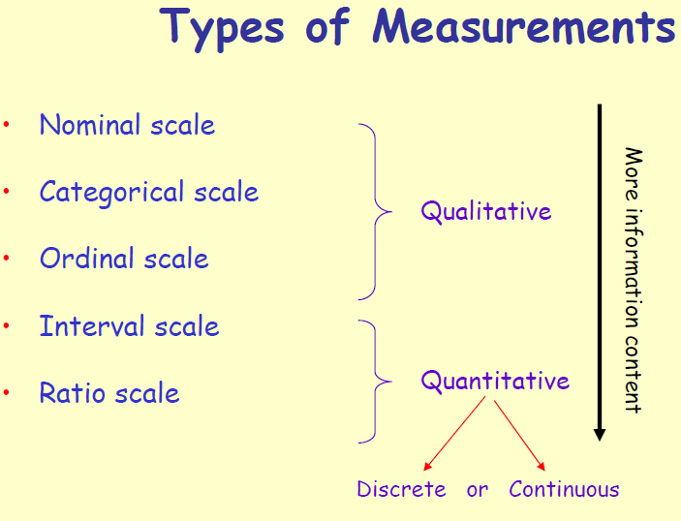

Slide 9
Types of Measurements: Examples
• Nominal: ID numbers, Names of people
• Categorical: eye color, zip codes
• Ordinal: rankings (e.g., taste of potato chips on a scale from 1-10), grades, height in {tall, medium, short}
• Interval: calendar dates, temperatures in Celsius or Fahrenheit, GRE (Graduate Record Examination) and IQ scores
• Ratio: temperature in Kelvin, length, time, counts

Slide 10
Feature Engineering
Goal: To get a matrix X and Y:
- If numerical values: process at once or better analyze first (normalization, discretization)
- If text or categorical: certainly need to process to convert to numerical type.
- Features could a result of two other features

Slide 11
Feature Scaling
Scale may differ with different features
For example: annual salary and number of children
- When changing Euclidian distance second parameter will have a minor impact:
Client x1: 100 000$ and 0 children
Client x2: 120 000$ and 5 children
New Client z: 105 000$ and 4 children
Distance p(z,x1) = 5000, p(z,x2) = 15000 SMTH is wrong…..
In such a case we need feature Scaling!
(mean normalization, feature scaling)

Slide 12
How to deal with Categorical parameters?

Slide 13
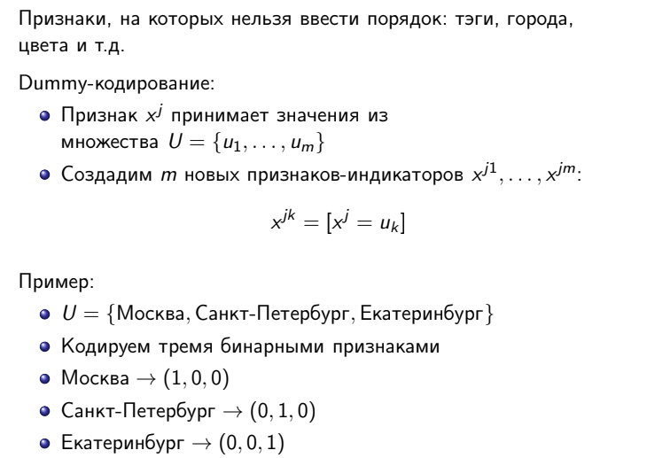

Slide 14

Unique Values
What if we have only one appearance of “Kokshetau”?
One of the coding features will take the value 1 on only one object
Such a sign does not make sense!
Decision:
Group all unique valued features to one
Category u is seldom, if where r – some parameter

Slide 15
Another example (Dummy Coding)
Objective: Predict whether a user clicks on an ad banner
Parameters:
User ID
Banner id
The identifier of the site on which the banner is displayed
Banner category id
With dummy coding, we get millions of signs!

Slide 16


Idea
Let the u1 banner click on average more often than banner u2
This is an important sign!
Replace categories with click probabilities
Counters:
Classification Problem, Y = {0, 1}
We estimate the probability of the first class, provided that sign:

Slide 17
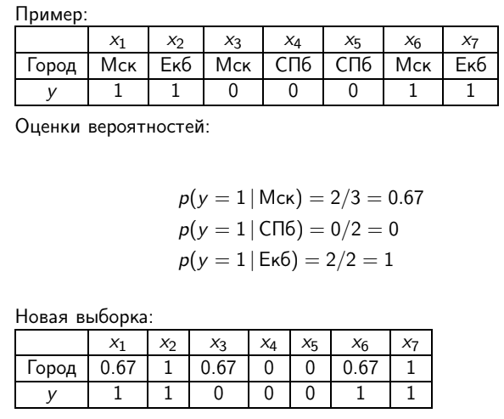
Example

Slide 18
How to deal with Text parameters?

Slide 19
Text parameters
The sign value xj is a sequence of words (w1, w2, ...).
Bag of words:
Conclusions about the text can even be mixed words
Words from the text belong to the dictionary W = {w1, ..., wm}
Create m new indicator signs xj1, ..., xjm:
xjk = nwk,
nwk - number of occurrences of the word wk in the document
An analogue of dummy coding, but now several signs may be more than zero
Example:
U = {student, street, home, student}
We encode with four binary signs
student, street, home, student → (2, 1, 0, 1)
street home→ (0, 1, 1, 0)

Slide 20


TF-IDF
Idea: to calculate not the number of occurrences of words, but their estimates importance for text
the more often a word appears in a document, the more important it is
the less often the word occurs in other documents, the it is more important
niw (term frequency) - the number of occurrences of the word w in the text
Nw (document frequency) - the number of texts containing w;
The importance of w for xj
TF (i, d) = niw - term frequency;
IDF (w) = log (l / Nw) - inverted document frequency.

Slide 21
Data pre-processing

Slide 22
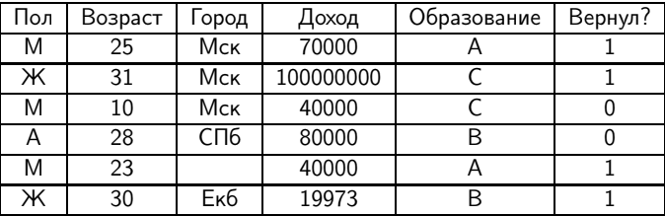
Example
What do these letters mean?
Error
Outlier?/Special?
Empty
Suspicious concretization
Empty NUMERICAL: Medium change OR Median Replacement
Empty Categorical: Replacing the most popular value Or
Replace with a new value Or Random selection from value distribution

Slide 23
Data pre-processing
Data could be dirty:
Noise
Outleirs
Missing values
“GIGO” – Garbage in garbage out.

Slide 24
There can be many problems in the data: omissions, outliers, incorrect values Outliers can be detected using interquartile range Gaps can be corrected by replacing with reasonable ones values

Slide 25
How to check the quality of the algorithm?

Slide 26
Types
By training sample the algorithm is tailored to this sample during retraining, the quality will be good in the absence of generalizing ability
Hold - out
Using cross validation

Slide 27
Hold-out
The sample is divided into two parts: training and validation.
In what ratio to break?
If the training sample is small, then the quality assessment will be too pessimistic
If the validation sample is small, then the estimate will be inaccurate
Typical choice: 70/30
Problems:
The result is highly dependent on the partition - each object participates either only in training, or only in validation
If you compare many models, there is a risk of fitting to specific validation sample

Slide 28
Cross-Validation
The sample is divided into k parts
Each in turn acts as a validation
Which k to choose?
Small k - pessimistic but accurate estimates
Large k - unbiased estimates with large variance
Typical choice: k = 5
Problem:
Need to train k algorithms

Slide 29
How to split a sample?
Objective: predicting layoffs of company employees in next half year
The number of layoffs is highly dependent on economic situations - distribution depends on time
If you break employees randomly, then the algorithm
"Peeps" into the distribution
Quality assessment will be overestimated - the algorithm knows information that is not available in real conditions
Need to be broken by time

Slide 30
How to split a sample?
Both methods assume that all objects belong to single distribution and independent
Task: predicting the speed of the traffic flow on sections of roads in Moscow
The speed in adjacent sections is almost the same - dependent objects
If you break sections randomly, then the algorithm
“Peeps” at neighboring sites in the same speed moment of time
Quality assessment will be overestimated - the algorithm knows information that is not available in real conditions
It is necessary to divide the plots according to proximity or by time

Slide 31
Feature Selection
How not to select features and lower the dimension:
We find the optimal signs throughout the sample
We evaluate the quality of the algorithm on new features with
using cross validation
Attributes selected to optimize quality.
algorithms on all objects from the sample!
How to select features and lower the dimension:
We select the next training and test samples in
cross validation
We find the optimal signs for the training sample
Checking quality on a test sample

Slide 32
Conclusion
Check the quality of the algorithm on the sample, different from teaching
You can evaluate quality by a delayed sample or by cross validation
Cross validation is better, but it works longer
If objects depend on each other or relate to different distributions, this must be taken into account when breaking up
You cannot select features before cross-validation

Slide 33
